Slide 1
COT5615: Math for Intelligent Systems I
Anand Rangarajan
Lecture 6

Slide 2
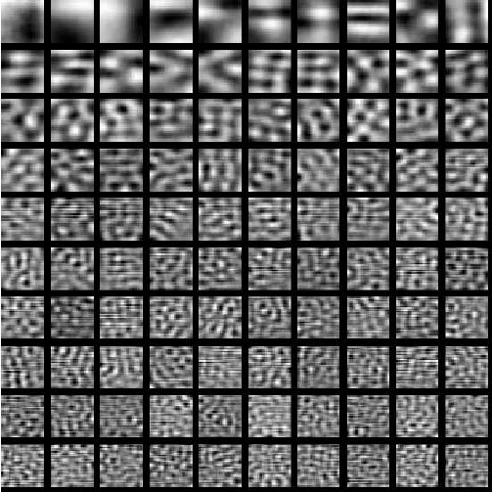
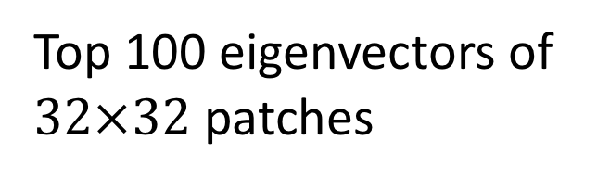
PCA of image patches
Top 100 eigenvectors of
$32×32$ patches

Slide 3
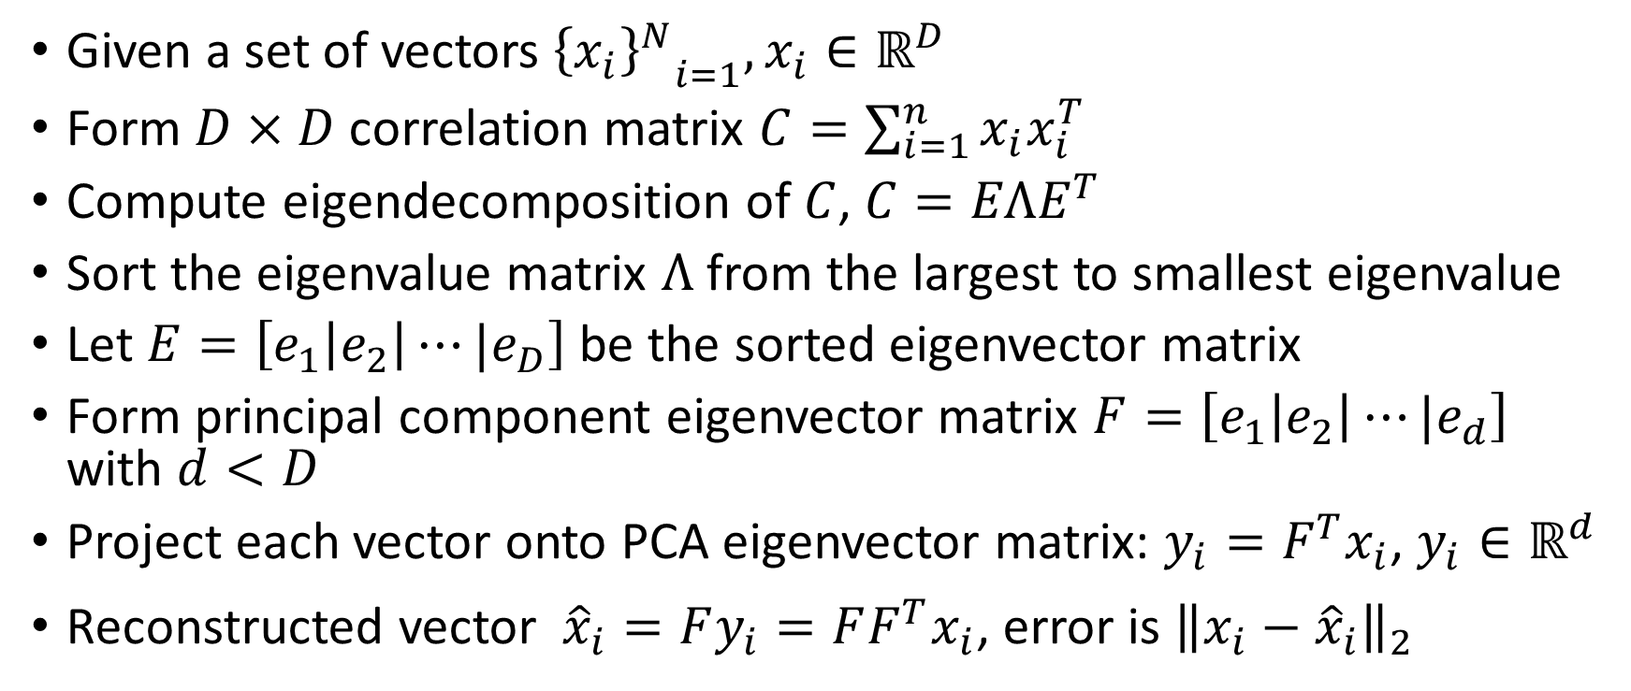
Principal Component Analysis (Version 0)
Given a set of vectors ${{\left\{x_{i}\right\}}^{N}}_{i=1},x_{i}∈ℝ^{D}$
Form $D×D$ correlation matrix $C=\sum_{i=1}^{n}{x_{i}x_{i}^{T}}$
Compute eigendecomposition of $C$, $C=EΛE^{T}$
Sort the eigenvalue matrix $Λ$ from the largest to smallest eigenvalue
Let $E=\left[e_{1}\left|e_{2}\right|⋯|e_{D}\right]$ be the sorted eigenvector matrix
Form principal component eigenvector matrix $F=\left[e_{1}\left|e_{2}\right|⋯|e_{d}\right]$ with $d<D$
Project each vector onto PCA eigenvector matrix: $y_{i}=F^{T}x_{i}$, $y_{i}∈ℝ^{d}$
Reconstructed vector ${\hat{x}}_{i}=Fy_{i}=FF^{T}x_{i}$, error is ${{{\left\|x_{i}−{\hat{x}}_{i}\right\|}_{2}}^{}}_{}$

Slide 4


What are Matrices Really?
Matrices are linear operators
They take in a vector and output another vector
Examples: Rotation, Scale
$$x$$
$$y=Ax$$

Slide 5
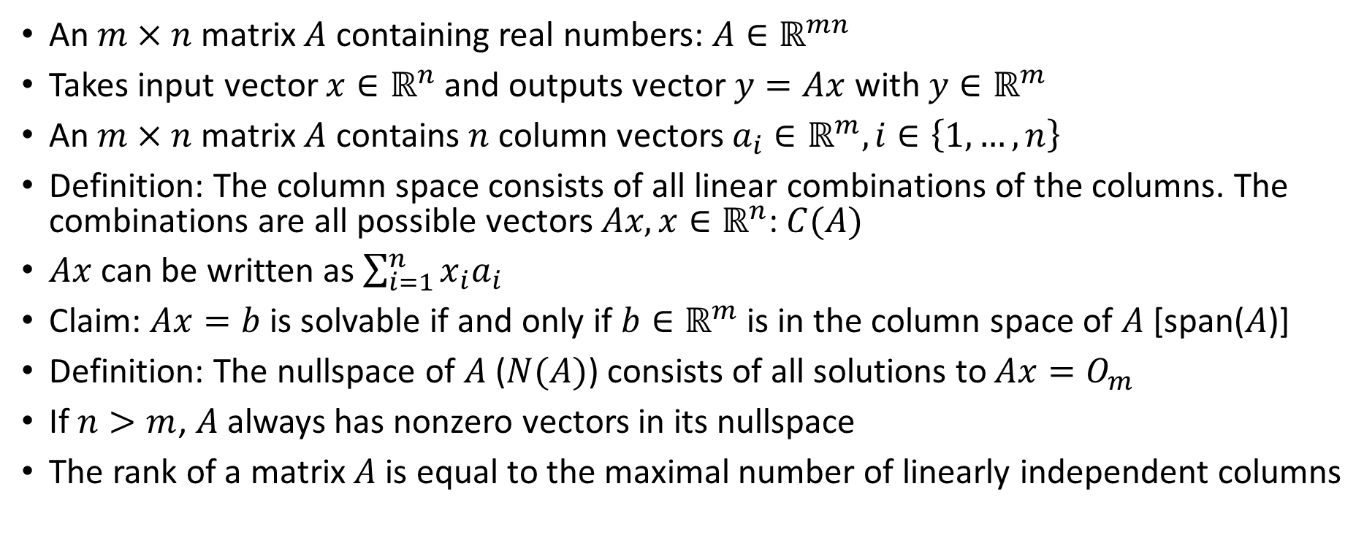
Linear Algebra Revisited
An $m×n$ matrix $A$ containing real numbers: $A∈ℝ^{mn}$
Takes input vector $x∈ℝ^{n}$ and outputs vector $y=Ax$ with $y∈ℝ^{m}$
An $m×n$ matrix $A$ contains $n$ column vectors $a_{i}∈ℝ^{m},i∈\left\{1,…,n\right\}$
Definition: The column space consists of all linear combinations of the columns. The combinations are all possible vectors $Ax, x∈ℝ^{n}$: $C(A)$
$Ax$ can be written as $\sum_{i=1}^{n}{x_{i}a_{i}}$
Claim: $Ax=b$ is solvable if and only if $b∈ℝ^{m}$ is in the column space of $A$ [span($A$)]
Definition: The nullspace of $A$ ($N(A)$) consists of all solutions to $Ax=O_{m}$
If $n>m$, $A$ always has nonzero vectors in its nullspace
The rank of a matrix $A$ is equal to the maximal number of linearly independent columns

Slide 6
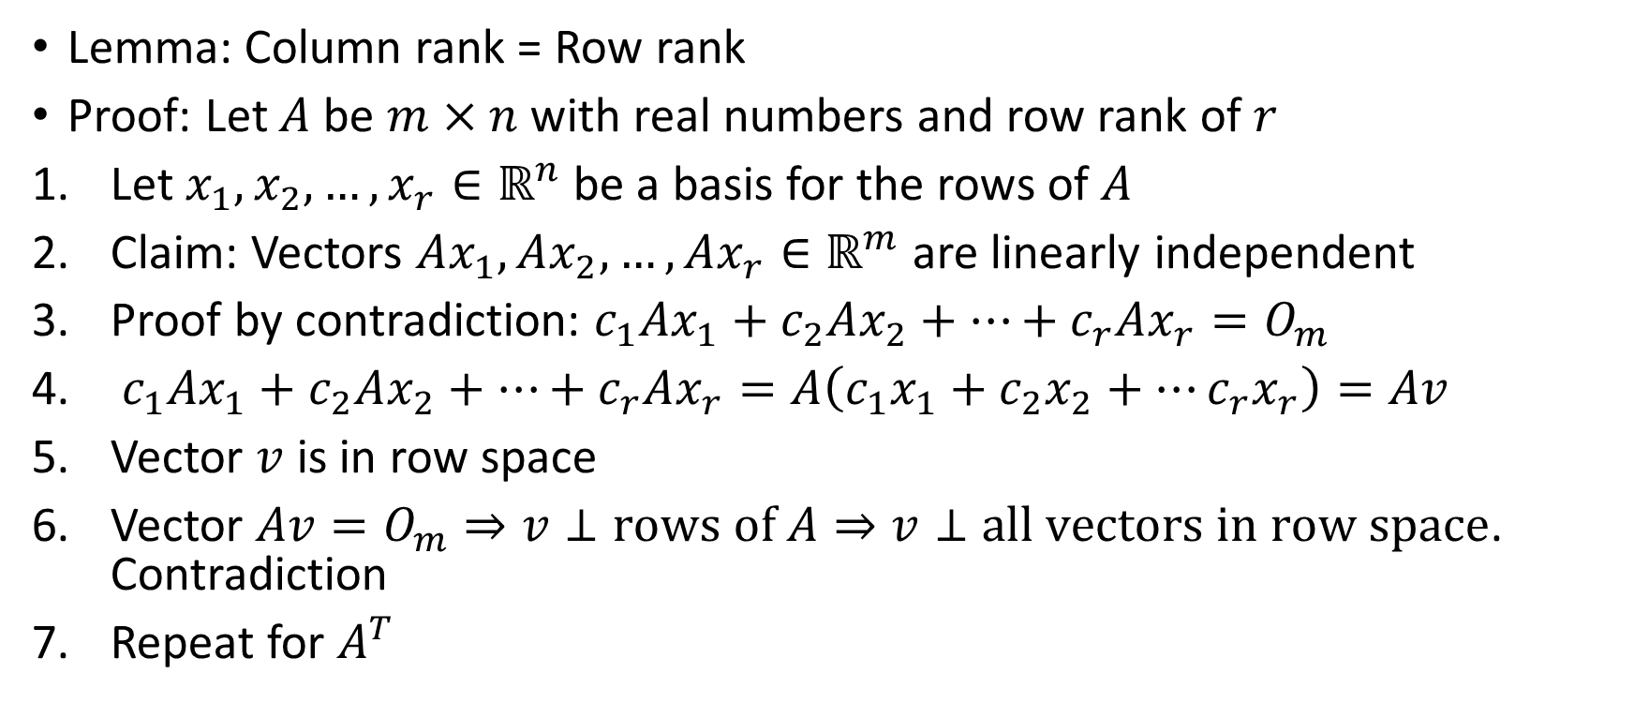
Rank of a matrix
Lemma: Column rank = Row rank
Proof: Let $A$ be $m×n$ with real numbers and row rank of $r$
Let $x_{1},x_{2},…,x_{r}∈ℝ^{n}$ be a basis for the rows of $A$
Claim: Vectors $Ax_{1},Ax_{2},…,Ax_{r}∈ℝ^{m}$ are linearly independent
Proof by contradiction: $c_{1}Ax_{1}+c_{2}Ax_{2}+…+c_{r}Ax_{r}=O_{m}$
$c_{1}Ax_{1}+c_{2}Ax_{2}+…+c_{r}Ax_{r}=A\left(c_{1}x_{1}+c_{2}x_{2}+…c_{r}x_{r}\right)=Av$
Vector $v$ is in row space
Vector $Av=O_{m}⇒v⊥rows of A⇒v⊥all vectors in row space$. Contradiction
Repeat for $A^{T}$

Slide 7
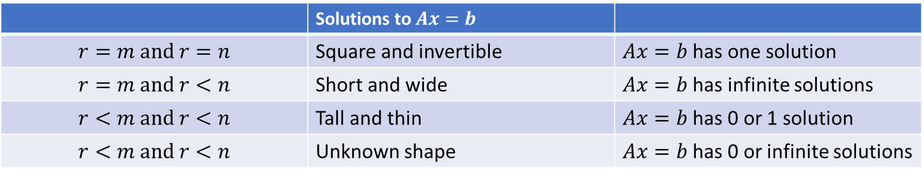


Solutions to $Ax=b$
Full column rank $r=n$ means one solution or none
Full row rank $r=m$ means one solution if $m=n$ or infinitely many if $m<n$
Four possibilities:
 | Square and invertible
 | Short and wide
 | Tall and thin
 | Unknown shape

